Slide 1

WHO AM I ?
0
Here you will find a brief introduction to my personality and what the likes and dislikes are of the person.
Goal is not to look for Positives and Negatives but instead to focus on the overall personality of any person which is very complex.
The strengths and weaknesses together create a personality and together they make a whole person.
Goals | What I strive to achieve.
Value to Org. | What real value I add to teams and organisations.
With others | How I interact with others to get what I want.
Disruptors | What impacts my ability to create positive contribution.
Likes | What attracts me and motivates me.

Slide 2
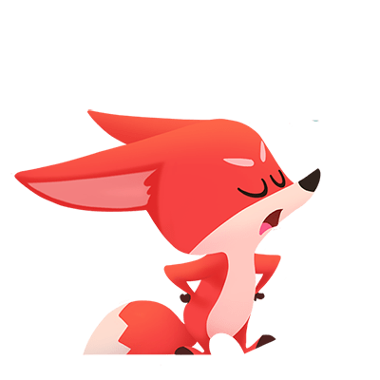
ESTABLISHER
1
Tend to be strong willed individuals, continually seeking new horizons. Self Reliant and Independent thinkers who prefer to find solutions on their own. They have a high need to achieve because they are ambitious and competitive, striving aggressively to achieve their goals. They are Dynamic, Adaptable and will do whatever it takes to overcome obstacles. In achieving their goals, they will be belligerent and might not care for other people’s feeling as much. They set high standards for themselves and others around and can be overly Critical when standards are not met.
Goals | New Opportunities, Ideas and Innovations
Value to Org. | Competent decision making. Will not pass the buck
With others | Will see competition, challenges and opposition in others.
Disruptors | Boredom and Loss of Control
Likes | Structure, Power of Control, High Standards

Slide 3

COMMUNICATOR
2
Love to be the center of attention and are very verbal, enthusiastic, excited, and excitable. They listen to others, like to collaborate with other enthusiastic people and wishes to inspire them. They exhibit confidence coupled with genuine interest in ideas and feeling of others. All this energy also makes them feel extremely dejected if they are rejected or disliked. They may need a constant dose of Approval. They also might sometimes lose focus on timelines and the tasks at hand.
Goals | Approval, Popularity
Value to Org. | Relieves tension and promotes others and themselves
With others | Presents confidence and inspires with praise and favours
Disruptors | Not being Praised or liked, being rejected.
Likes | A supportive and collaborative environment

Slide 4

SPECIALIST
3
Patience, calmness and gentle openness defines specialists well. They are often open to others' points of view and value positive interaction with others. They are not outgoing by nature and rely on others, more assertive, Expects people to take the lead. They like doing practical jobs with structure and procedures. They value trust strongly and enjoy being part of a smaller team where they are valued and appreciated. They are typically resistant to change and need help moving with new projects or developing short cuts to meet deadlines.
Goals | Steadiness, Predictability
Value to Org. | Dependable, Consistent, & Maintains steady pace.
With others | Look to others to start relationships and will always accommodate other’s needs if present.
Disruptors | Rapid Change and disorganized Environment.
Likes | An authoritative motivator, Focussed work on practical assigned tasks.

Slide 5
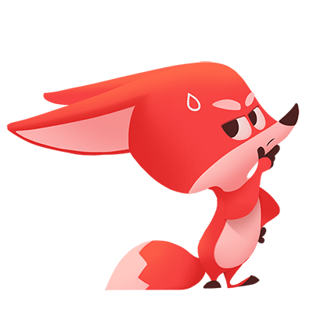
LOGICAL THINKER
4
Emphasize on facts when drawing conclusions or planning actions. They seek accuracy and correctness in everything they do. They are also generally cautious and reluctant to reveal information about themselves or their ideas unless absolutely necessary. Their innate lack of assertiveness and unwillingness to become involved in confrontational situations makes it difficult for them to achieve their goals. Despite not being aggressive, they will use existing rules, facts and structure to convince others to gain control over their environment.
Goals | Being Correct, Right and Accuracy
Value to Org. | Organizing Facts and Working with precise detail.
With others | Not very easy to relate and uses facts and procedures as tools for communication
Disruptors | Confrontation especially related to their work
Likes | An environment where they are not questioned or criticised.

Slide 6

INFLUENCER
5
Assertive and capable of both direct, dynamic action or charming sociability as a situation demands. They have clear goals in life with the determination and commitment to achieve them. They are happiest when they’re on an exciting new adventure. Use Authority of position (power) and friendship (persuasion) interchangeably as the need arises to achieve their desires and goals. They are typically verbally active and are outgoing and quick paced. They have no fear of confrontation and address issues directly. They constantly desire and seek out a challenge.
Goals | Control, Real Authority over Environment & Audience
Value to Org. | Initiates change and even helps to achieve it. Delegates responsibilities and is confident.
With others | Combination of Charm and intimidation to help drive the people towards the goal.
Disruptors | Overly Complex Environment and Fixed Environment where change is not appreciated.
Likes | Success and Recognition.

Slide 7
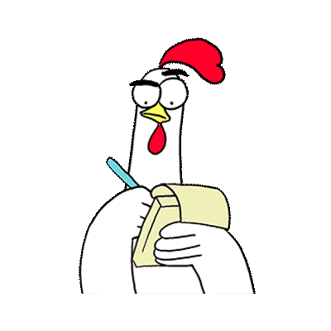
WORKER
6
An extremely rare profile. They are dependable, persistent, and tenacious in nature and very task oriented. They like to get things done in a friendly but thorough manner. They are both energetic, stable and work well under pressure. They have a strong “I have to do it myself attitude” and delegating tasks to those they feel that they can trust completely. Most times we find them to be poor communicators. Due to this, they can seem friendly to a few. They are extremely suspecting and cautious to others.
Goals | Getting the Task done.
Value to Org. | Gets tasks completed by careful planning and being self driven. Will push through obstacles.
With others | Accountable for their own work. Will work with other only if they trust them completely.
Disruptors | Not being allowed to complete the tasks, work resulting in conflict with others.
Likes | Challenging environments with larger goals.

Slide 8
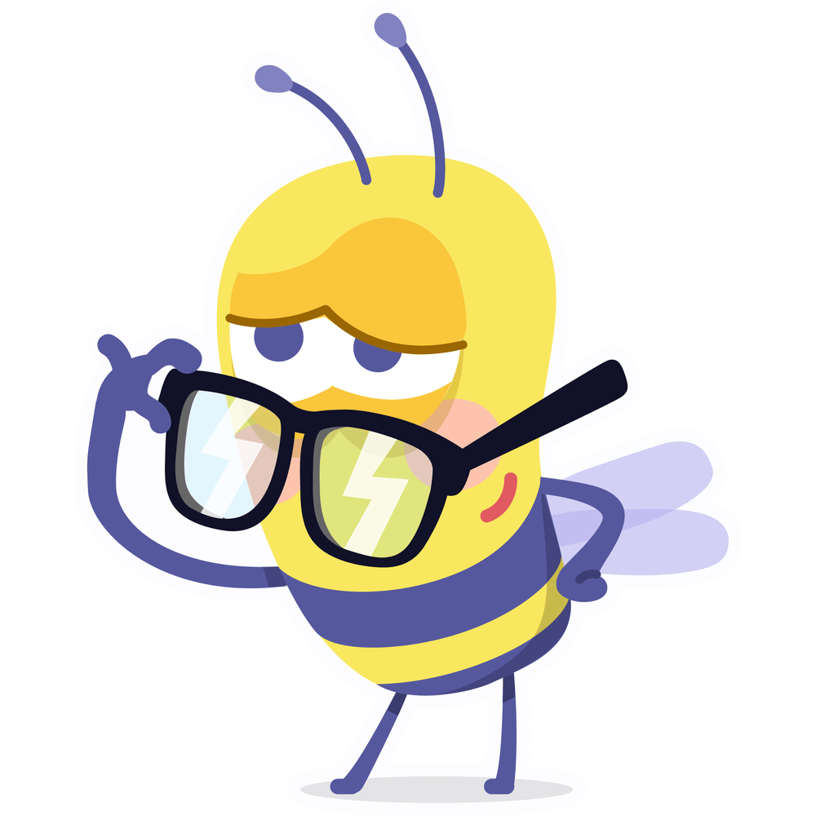
PERFECTIONIST
7
A tenacious personality with a goal to get the task perfectly. Will only take decision on the task after very careful evaluation of all possibilities. They are typically straight forward and blunt and are quite happy work by themselves. They support change where necessary but are extremely cautious of large changes. Their need for perfection acts as a counterbalance for quick and tangible results. They look for systematic approaches and a high quality of work both in themselves and others.
Goals | High Standard & Accomplishments
Value to Org. | Can challenge the team to raise the bar on all aspects and sets goals for others objectively.
With others | Is direct and straightforward with people.
Disruptors | Gets stuck in details, Non willingness to improve standards.
Likes | Time and Resources to get things done well the first time

Slide 9
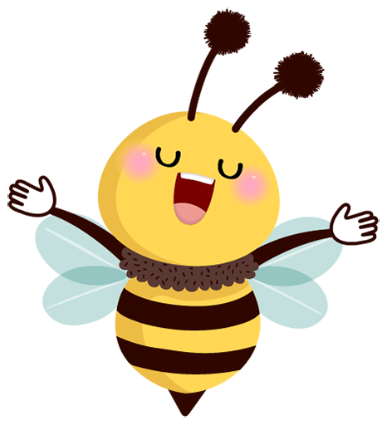
COUNSELOR
8
They are highly people-focused and help build good teamwork using simple charm and persuasion. They are good listeners, makes people feel warm and taken care of and therefore are well-liked. You will find them assisting and volunteering for other’s benefit often. Since they value mental stimulation, can become easily bored. Doesn’t like confrontation and hence in certain situations, they might not get into active problem solving. For similar reasons, they find it a little hard to give direct orders or commands. They are always “People First”.
Goals | Friendship, Happiness, Group Acceptance
Value to Org. | Focuses on service and provides a stable and empathetic environment.
With others | Positive attitude with an “Open Door” policy. Generally see good in others and expect them to be tolerant.
Disruptors | Dissension and Conflict with peers
Likes | Favourable environment where they feel loved and respected.

Slide 10
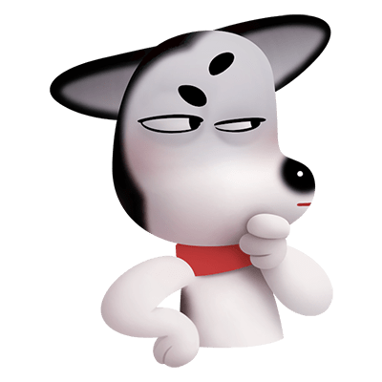
ASSESSOR
9
They have 2 sides within them, and the circumstances determine if their Relaxed, open minded and creative side comes to the fore or if their compliant and obedient side. In the right environment, they are great creative thinkers who get tasks done by being articulate and persuasive rather than giving commands. They like to address things individually while also seeking attention form everyone. They might find themselves at times overworking to the point of exhaustion. They like to use their analytical skills to uncover exciting new ideas.
Goals | Achieve High Quality Results
Value to Org. | Help in creating new ideas and avenues for growth and also helps keep the ship stable when needed.
With others | Articulate in communication and persuasive to get things done. Sometimes overly critical and caustic.
Disruptors | Pressure and Structured environments can render them restless or reserved to simple compliance
Likes | An ability and be creative and provide results.

Slide 11

IMPLEMENTOR
10
Dependable, Detail Oriented and Pragmatic. Fit well in a team setting and like to do practical jobs and usually see them to completion. They like traditions and structure and don’t necessarily want and seek constant change. They have a lot of patience, combined with accuracy and precision to get the job done. They may sometimes get bogged down in details with complex tasks. When they have adequate data and confidence on a particular area, they do take decisions on their own. They are calm and rational and rarely provide inputs in a group setting.
Goals | Stability and Simple Predictable Achievements
Value to Org. | Can work diligently on getting the tasks done. Complete with patience and thoughtfulness.
With others | Says Yes to avoid conflict. Expects high standards from fellow team members.
Disruptors | Takes time to adapt to changes, but will eventually get there.
Likes | Being recognized for quality and team work

Slide 12
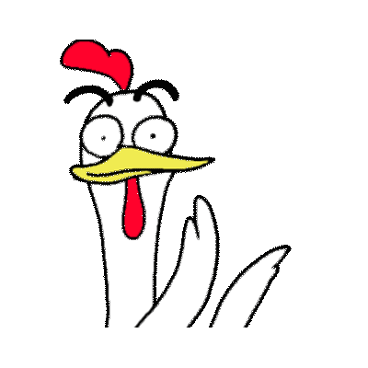
MOTIVATOR
11
Independence and self confidence are the key drivers. They have a high sense of responsibility along with a combination of patience and proactivity, which makes them excellent motivators or persuaders. They demonstrate a ready willingness to take on work and even take on initiatives. They bring to the front a strong underlying sense of determination and assertiveness whenever they find themselves in demanding situations. They get results and consider options before execution but do not get bogged down by too much detail or accuracy.
Goals | High degree of control over their circumstances to achieve their ambitions
Value to Org. | Helps rally the support and buy in to make progress and change via new initiatives.
With others | Easy and great communication, while being assertive of own goals and ideas.
Disruptors | Being asked to look into too much detail and not finding closeness in a relationship.
Likes | Building Relationships and Achieving Results equally

Slide 13
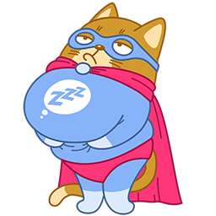
LEADER
12
Always driving to make things better. Speed of response and sense of urgency are defining characteristics. They are rooted in dynamicity and steady environments bore them easily. They find a balance between personal ambitions and group goals. Though generally formal in nature, their personality evolves based on the situation from being charming to being outright direct and forthright. They have little patience in the inabilities of others and expect the best out of everyone around them. Will end up doing things on their own if not felt supported.
Goals | Independence in getting things done their way.
Value to Org. | Accomplishes goals with the team consistently and drives team to a high standard of competence.
With others | Expects others to bring their best performance and challenges them accordingly.
Disruptors | Their view points being ignored and being “managed” by someone else.
Likes | High quality results in their own way

Slide 14
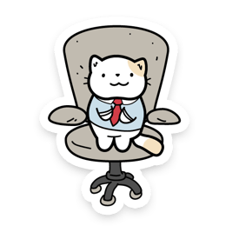
MANAGER
13
Driven, clear-minded, practical, and choose their words carefully. They possess the drive, the ability to track detail and the desire to build the harmony that is needed to run a team. While being good executors, they rarely bring in imagination and vision possessed to create innovative initiatives. They reveal their own ideas after careful mental processing. They make decisions around practical and rational considerations and may be frustrated by the emotions of others. They can be dominant or supportive as the situation demands it.
Goals | Approval, Popularity
Value to Org. | Relives tension and promotes others and themselves
With others | Presents confidence and inspires with praise and favours
Disruptors | Not being Praised or liked, being rejected.
Likes | A supportive and collaborative environment

Slide 15
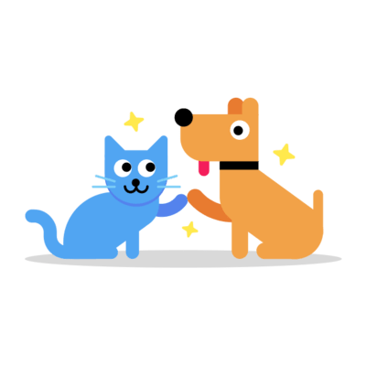
MEDIATOR
14
Will rarely display overtly assertive or direct behaviour. Instead, they will try to achieve their ends through communication, using their persuasive abilities or the powers of rational discussion. Typically, not very ambitious and doesn’t set distinct goals for themselves. They are happy being good at something and often aim to gain some expertise in an area. Works well as part of a team or group, being both friendly and co-operative in style, and ready to accept others' ideas. They like a lot to learn, also to teach and like feeling secure in their position.
Goals | Being good at Something and Personal Growth
Value to Org. | Skilled in Something Technical and is a Good People Problem Solver
With others | Development of proper procedures and actions and teaching to instil self discipline.
Disruptors | Loss of recognition as an expert. Unable to teach and impart knowledge.
Likes | Likes to improve himself in a stress free environment.

